Slide 1
October 24, 2023
Gridworld: value iteration VS linear programming
Reinforcement Learning
Samuele Lippolis | Gaia Marsich
Gridworld: value iteration VS linear programming
S. Lippolis, G. Marsich
1/40

Slide 2
Index
October 24, 2023
Introduction
Markov decision process
Gridworld
Value iteration
Some theory
Ex1: one goal-cell
Ex2: multiple goal-cells
Ex3: considering random actions
Linear programming
Optimization: brief introduction
Linear programming for Gridworld
Solution discussion
Comparison
Conceptual comparison
Performance comparison
Gridworld: value iteration VS linear programming
S. Lippolis, G. Marsich
2/40

Slide 3
1. Introduction
October 24, 2023
1. Introduction
Gridworld: value iteration VS linear programming
S. Lippolis, G. Marsich
3/40

Slide 4
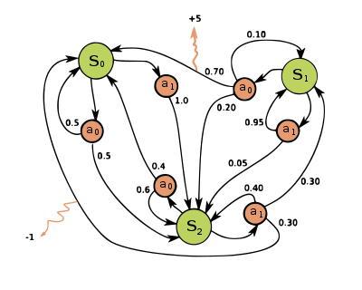
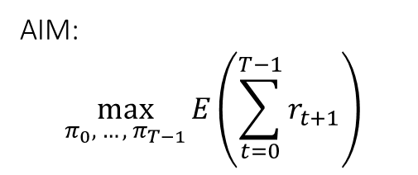
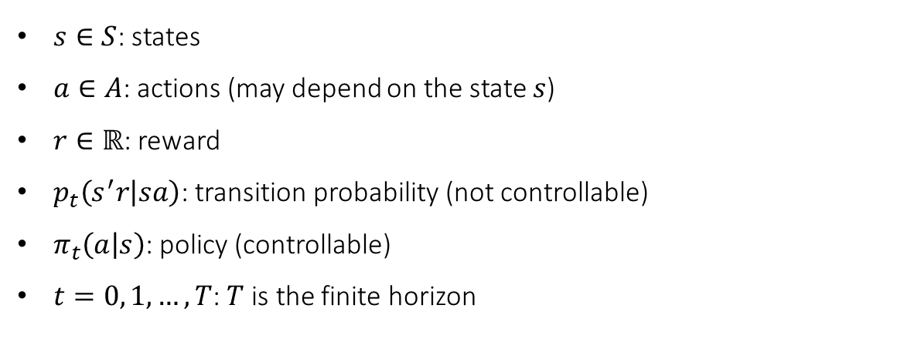
1. Introduction
A. Markov decision process
October 24, 2023
$s∈S$: states
$a∈A$: actions (may depend on the state $s$)
$r∈ℝ$: reward
$p_{t}\left(s^{′}r | sa\right)$: transition probability (not controllable)
$π_{t}\left(a | s\right)$: policy (controllable)
$t=0, 1, …, T$: $T$ is the finite horizon
AIM:
$$\max_{π_{0}, …, π_{T−1}}{E\left(\sum_{t=0}^{T−1}{r_{t+1}}\right)}$$
Gridworld: value iteration VS linear programming
S. Lippolis, G. Marsich
4/40

Slide 5
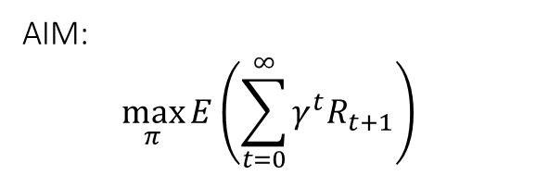
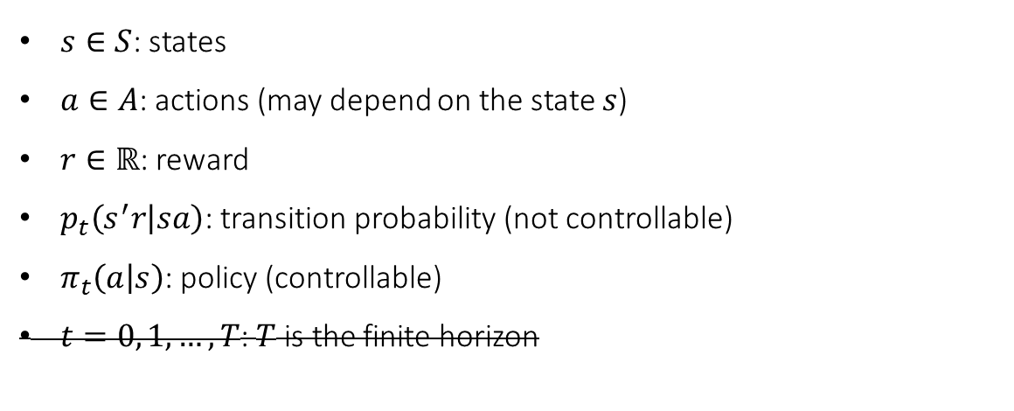
1. Introduction
A. Markov decision process
October 24, 2023
$s∈S$: states
$a∈A$: actions (may depend on the state $s$)
$r∈ℝ$: reward
$p_{t}\left(s^{′}r | sa\right)$: transition probability (not controllable)
$π_{t}\left(a | s\right)$: policy (controllable)
$t=0, 1, …, T$: $T$ is the finite horizon
AIM:
$$\max_{π}{E\left(\sum_{t=0}^{∞}{γ^{t}R_{t+1}}\right) }$$
Gridworld: value iteration VS linear programming
S. Lippolis, G. Marsich
4/40

Slide 6
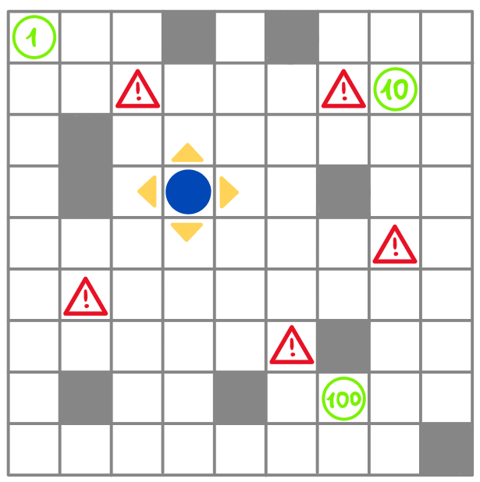




1. Introduction
B. Gridworld
October 24, 2023
RULES:
- a grid with Lx columns and Ly rows
- Nblocks wall-cells
- a list goals and a list rewards_list
- the agent may go:
- right
- left
- up
- down
(- a list dangers)
AIM: reach one goal-cell and get the reward
Gridworld: value iteration VS linear programming
S. Lippolis, G. Marsich
5/40

Slide 7
2. Value iteration
October 24, 2023
2. Value iteration
Gridworld: value iteration VS linear programming
S. Lippolis, G. Marsich
6/40

Slide 8
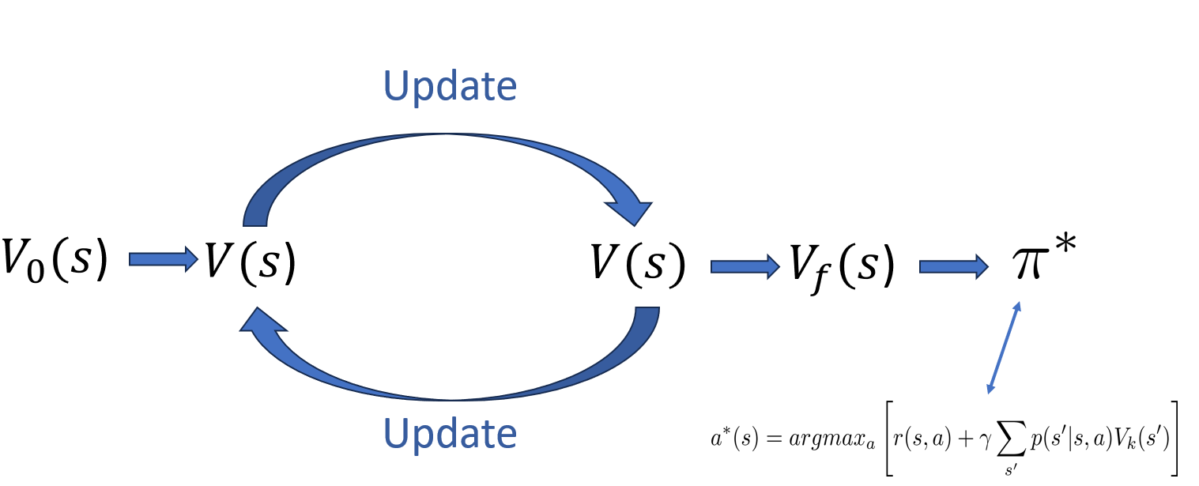
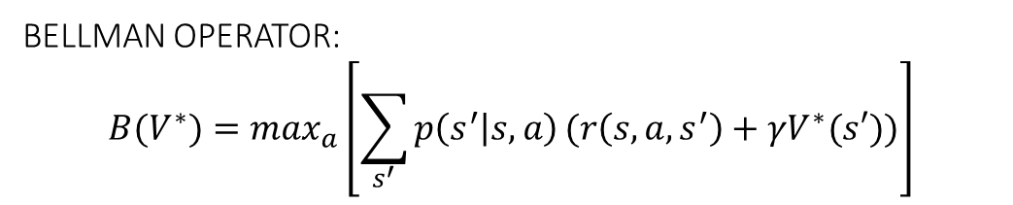
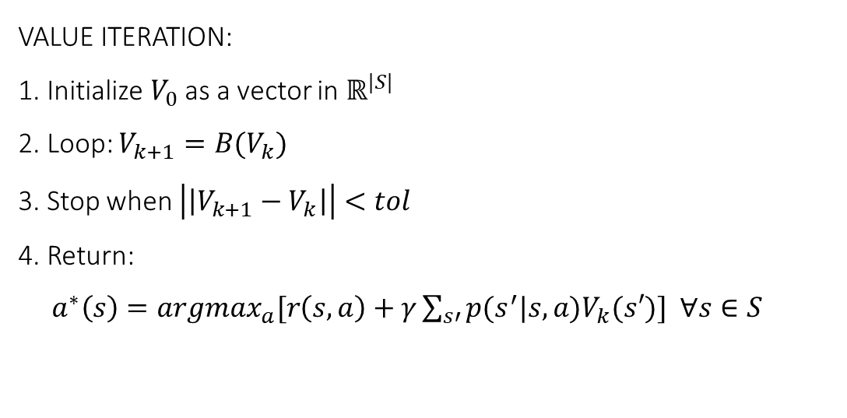
2. Value iteration
A. Some theory
October 24, 2023
BELLMAN OPERATOR:
$$B(V^{∗})=\max_{a}\left[\sum_{s^{′}}{p\left(s^{′} | s, a\right)}(r\left(s, a, s^{′}\right)+γV^{∗}(s′))\right]$$
VALUE ITERATION:
1. Initialize $V_{0}$as a vector in $ℝ^{|S|}$
2. Loop: $V_{k+1}=B(V_{k})$
3. Stop when $\left|\left|V_{k+1}−V_{k}\right|\right|<tol$
4. Return:
$a^{∗}\left(s\right)={argmax}_{a}[r\left(s,a\right)+γ\sum_{s′}{p(s^{′}|s, a)V_{k}(s′)}]$ $∀s∈S$
Gridworld: value iteration VS linear programming
S. Lippolis, G. Marsich
7/40

Slide 9
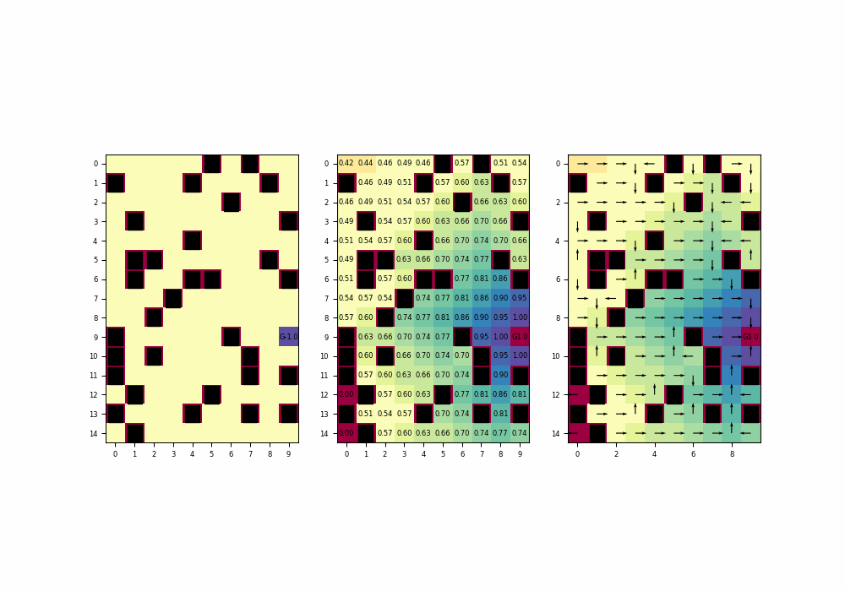
2. Value iteration
B. Ex1: one goal-cell
October 24, 2023
One goal-cell: some possible gridworlds
Gridworld: value iteration VS linear programming
S. Lippolis, G. Marsich
8/40

Slide 10
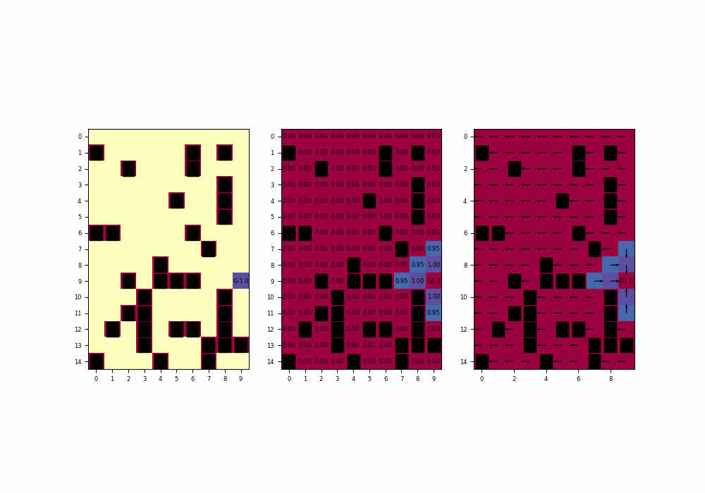
2. Value iteration
B. Ex1: one goal-cell
October 24, 2023
(1) Changing max_n_of_iterations
Gridworld: value iteration VS linear programming
S. Lippolis, G. Marsich
9/40

Slide 11
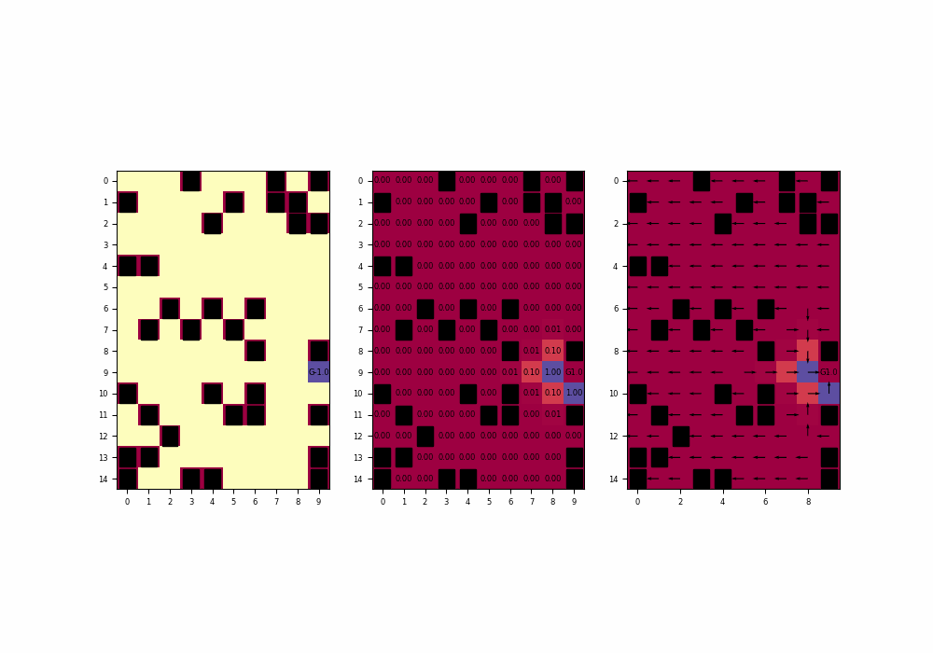
2. Value iteration
B. Ex1: one goal-cell
October 24, 2023
(2) Changing gamma
Gridworld: value iteration VS linear programming
S. Lippolis, G. Marsich
10/40

Slide 12
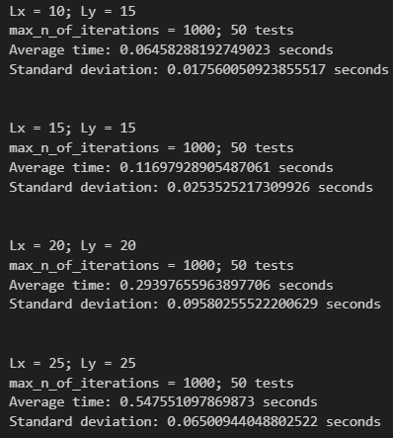
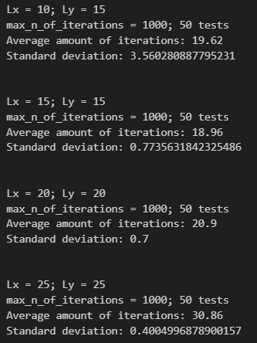
2. Value iteration
B. Ex1: one goal-cell
October 24, 2023
(3) Time to fall below tolerance
(4) Number of iterations to converge
Gridworld: value iteration VS linear programming
S. Lippolis, G. Marsich
11/40

Slide 13
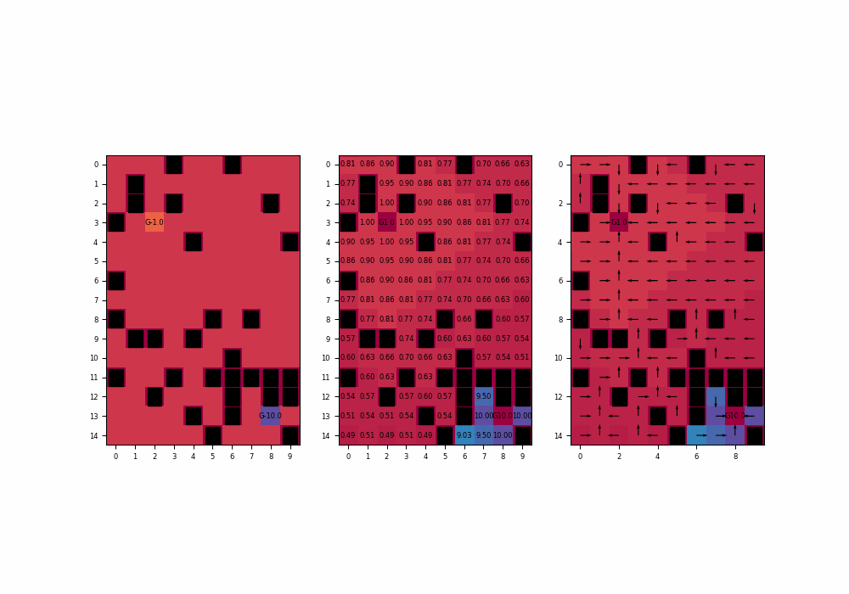
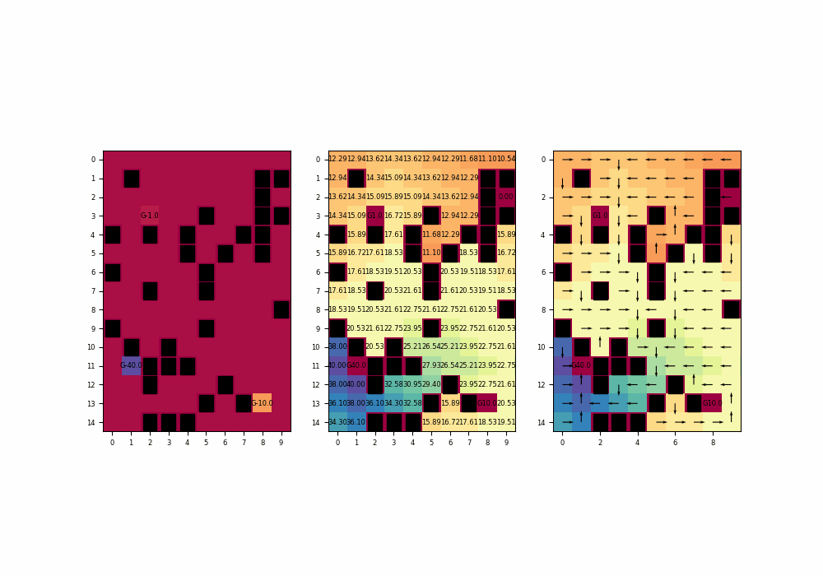
2. Value iteration
C. Ex2: multiple goal-cells
October 24, 2023
Multiple goal-cells: some possible gridworlds
2 goal-cells
3 goal-cells
Gridworld: value iteration VS linear programming
S. Lippolis, G. Marsich
12/40

Slide 14
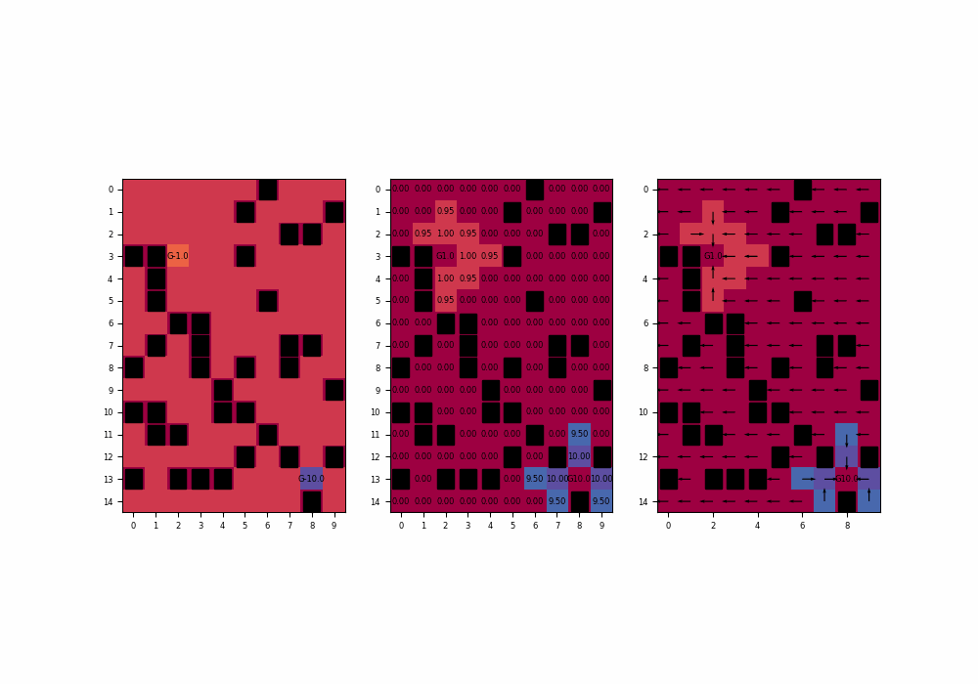
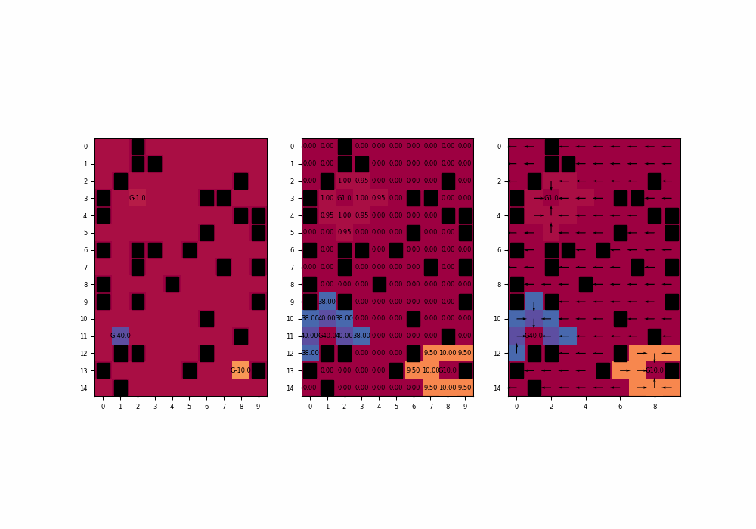
2. Value iteration
C. Ex2: multiple goal-cells
October 24, 2023
(1) Changing max_n_of_iterations
2 goal-cells
3 goal-cells
2 goal-cells
3 goal-cells
Gridworld: value iteration VS linear programming
S. Lippolis, G. Marsich
13/40

Slide 15
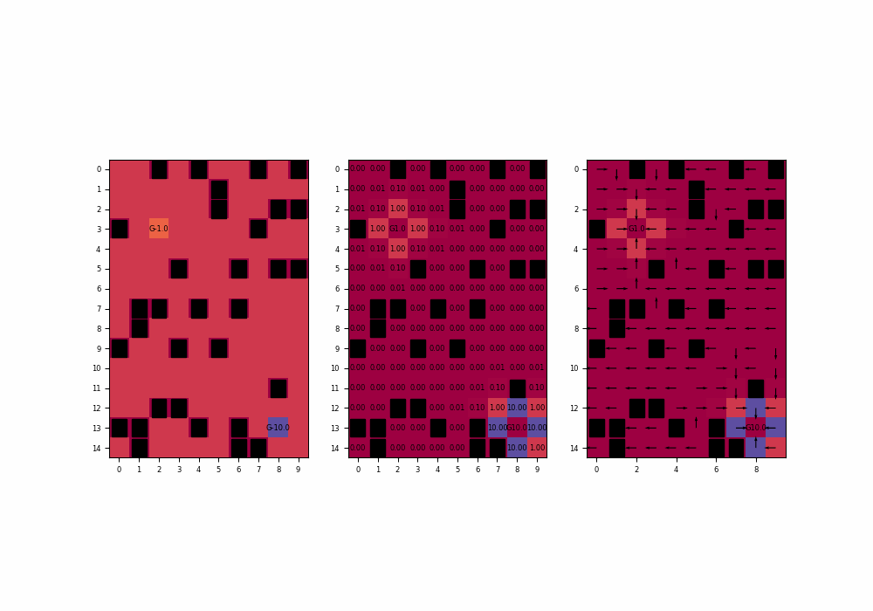
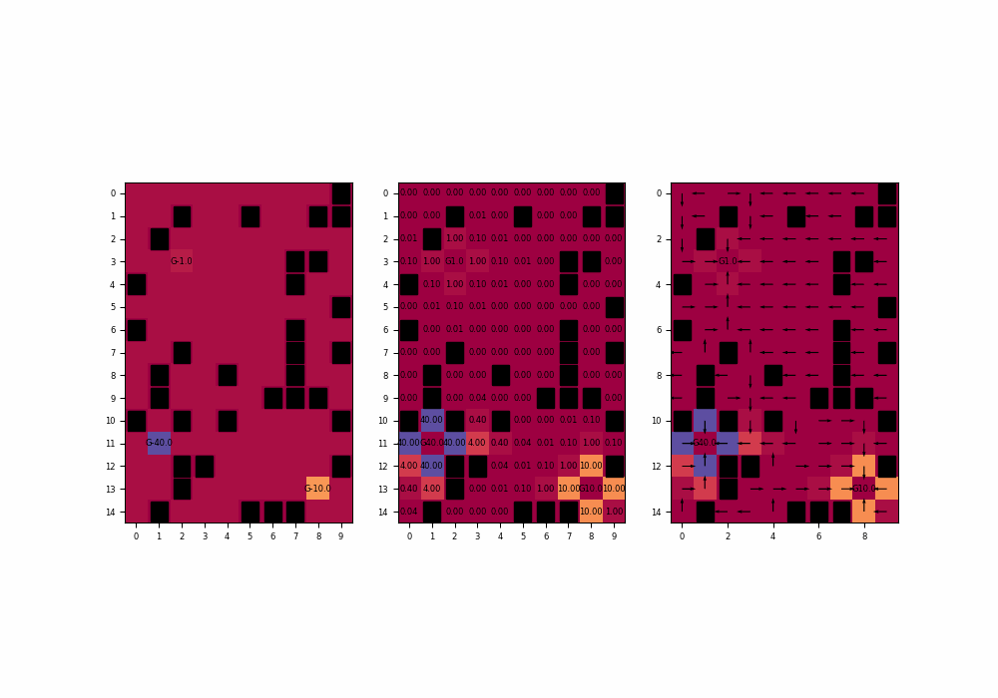
2. Value iteration
C. Ex2: multiple goal-cells
October 24, 2023
(2) Changing gamma
2 goal-cells
3 goal-cells
Gridworld: value iteration VS linear programming
S. Lippolis, G. Marsich
14/40

Slide 16
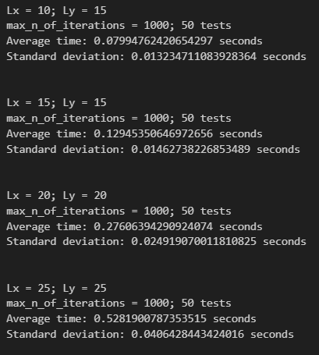
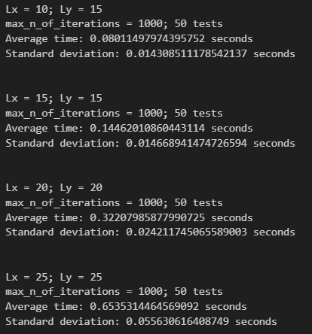
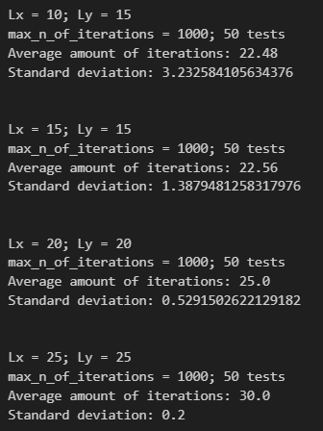
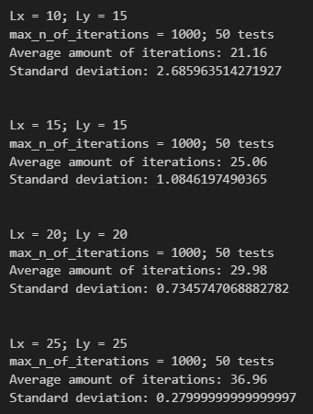
2. Value iteration
C. Ex2: multiple goal-cells
October 24, 2023
(3) Time to fall below tolerance
(4) Number of iterations to converge
2 goal-cells
3 goal-cells
2 goal-cells
3 goal-cells
Gridworld: value iteration VS linear programming
S. Lippolis, G. Marsich
15/40

Slide 17
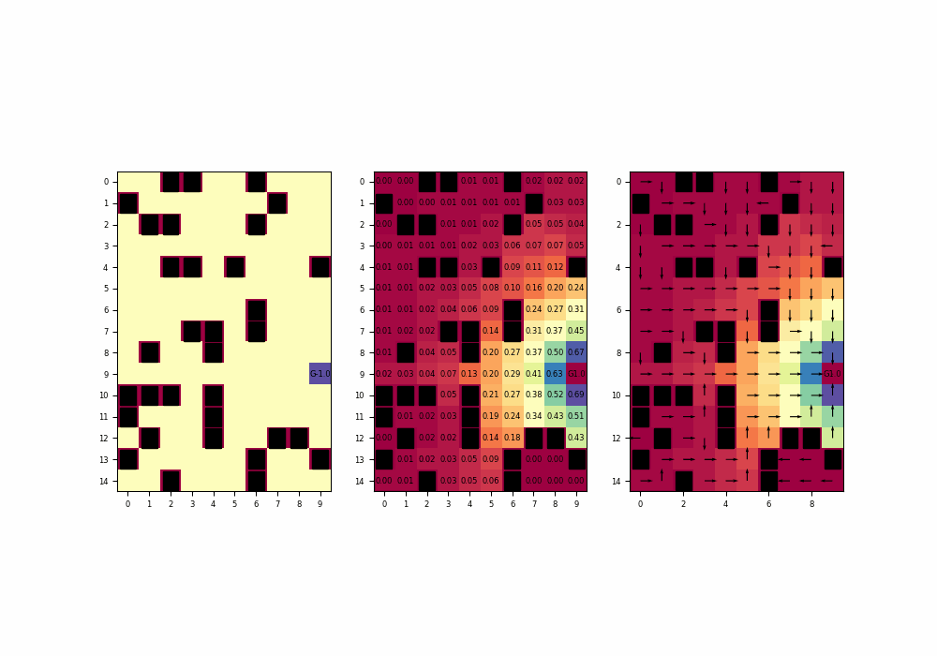
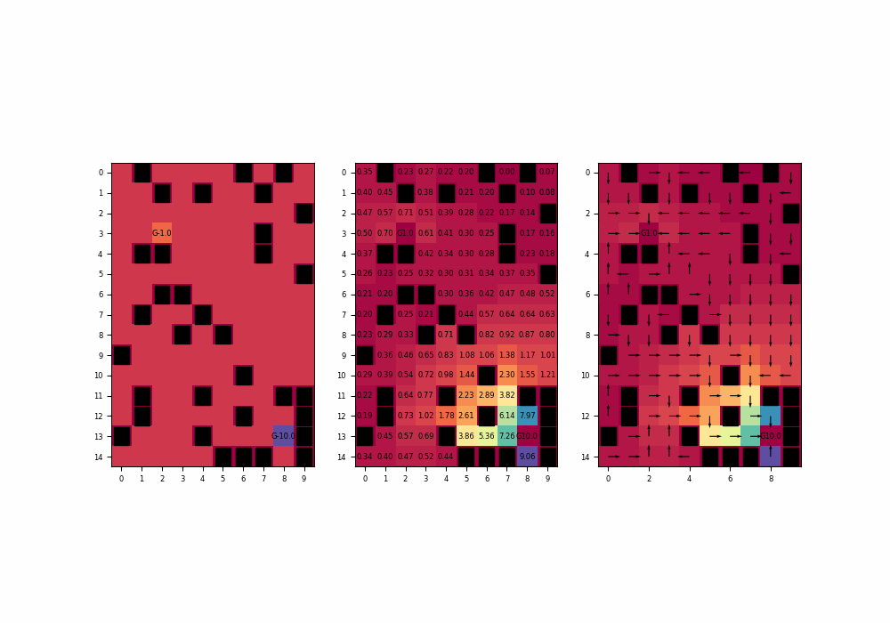
2. Value iteration
D. Ex3: considering random actions
October 24, 2023
(1) Changing p
1 goal-cell
2 goal-cells
Gridworld: value iteration VS linear programming
S. Lippolis, G. Marsich
16/40

Slide 18
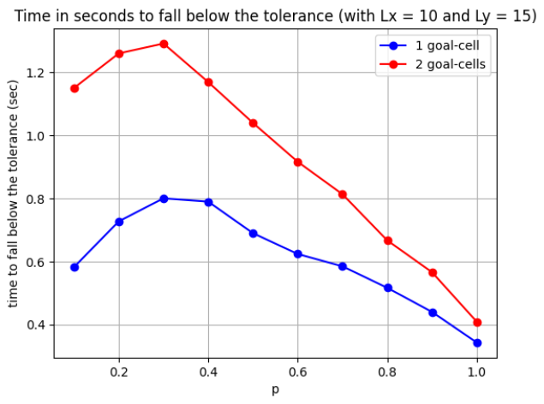
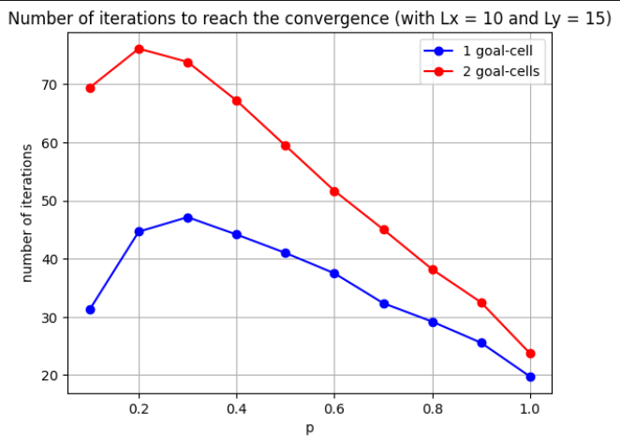
2. Value iteration
D. Ex3: considering random actions
October 24, 2023
(2) Time to fall below tolerance
(3) Number of iterations to converge
Gridworld: value iteration VS linear programming
S. Lippolis, G. Marsich
17/40

Slide 19
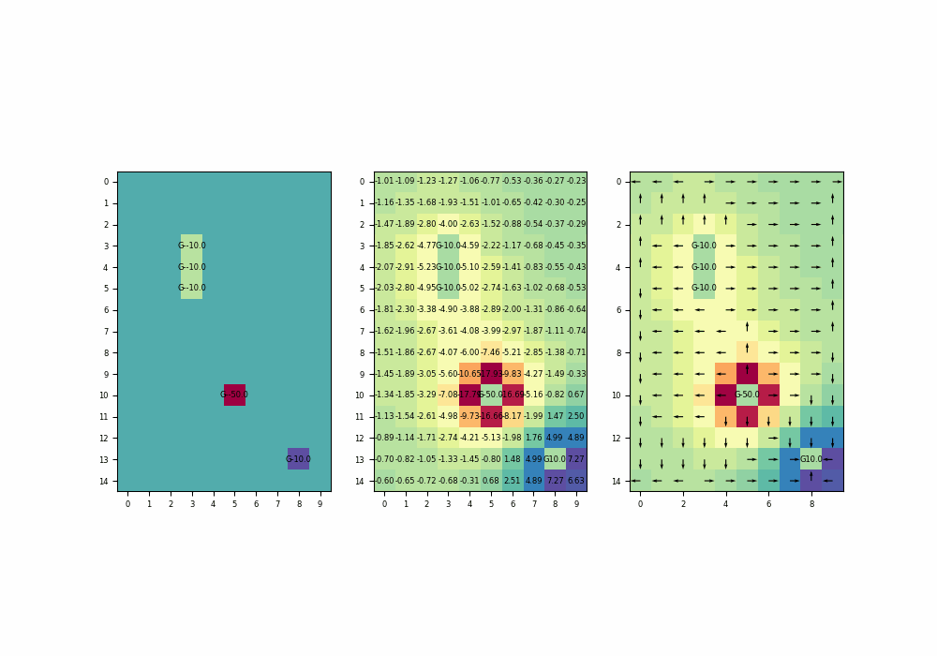
2. Value iteration
D. Ex3: considering random actions
October 24, 2023
Multiple goals: no wall-cells, p increasing
Gridworld: value iteration VS linear programming
S. Lippolis, G. Marsich
18/40

Slide 20
3. Linear programming
October 24, 2023
3. Linear programming
Gridworld: value iteration VS linear programming
S. Lippolis, G. Marsich
19/40

Slide 21
3. Linear programming
A. Optimization: brief introduction
i. Idea
October 24, 2023
You have options. Each option has a cost.
cost
options
Gridworld: value iteration VS linear programming
S. Lippolis, G. Marsich
20/40

Slide 22
3. Linear programming
A. Optimization: brief introduction
i. Idea
October 24, 2023
The goal is to find the option with the minimum cost (or the maximum).
cost
options
Gridworld: value iteration VS linear programming
S. Lippolis, G. Marsich
21/40

Slide 23
3. Linear programming
A. Optimization: brief introduction
i. Idea
October 24, 2023
The number of options could be discrete or infinite.
An instance of the infinite options is the case of a real function.
cost
options
Gridworld: value iteration VS linear programming
S. Lippolis, G. Marsich
22/40

Slide 24
3. Linear programming
A. Optimization: brief introduction
i. Idea
October 24, 2023
Cost function
Decision variable
Constraints
Optimization problem formalisation
The constraints shrink the searching space
Gridworld: value iteration VS linear programming
S. Lippolis, G. Marsich
23/40

Slide 25
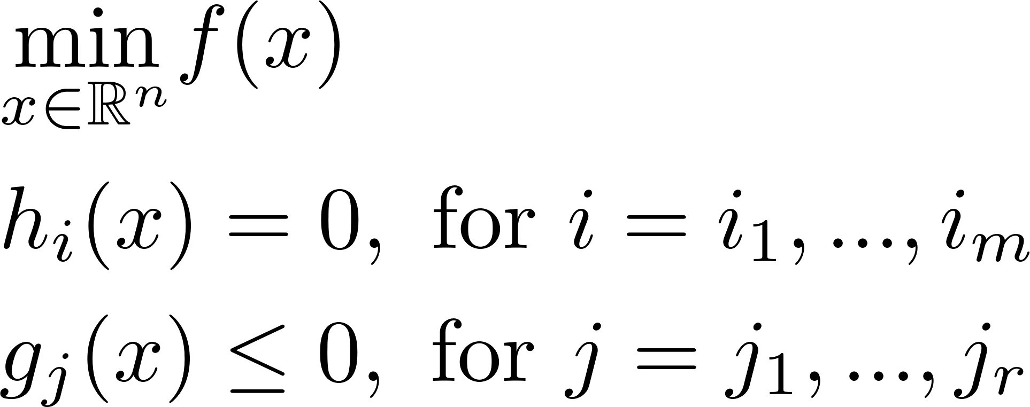


3. Linear programming
A. Optimization: brief introduction
i. Idea
October 24, 2023
Cost function
Decision variable
Constraints
$$≥$$
The constraints shrink the searching space
Gridworld: value iteration VS linear programming
S. Lippolis, G. Marsich
24/40

Slide 26
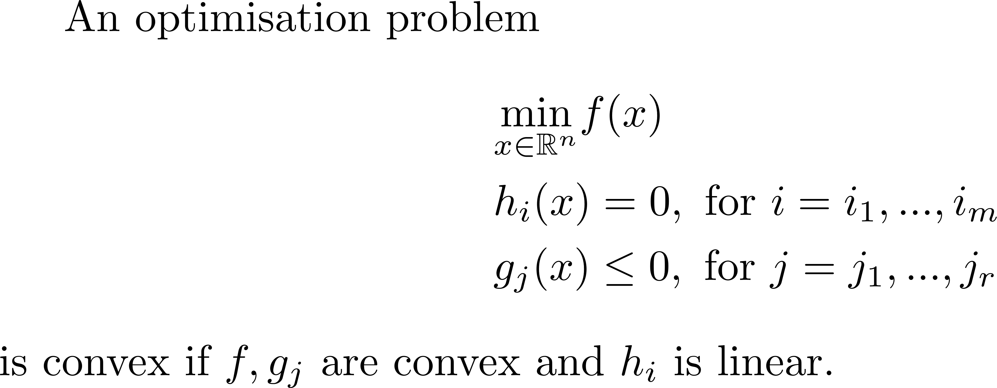
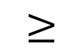

3. Linear programming
A. Optimization: brief introduction
ii. Convex optimization
October 24, 2023
$$≥$$
Why is h asked to be linear and not convex?
Gridworld: value iteration VS linear programming
S. Lippolis, G. Marsich
25/40

Slide 27
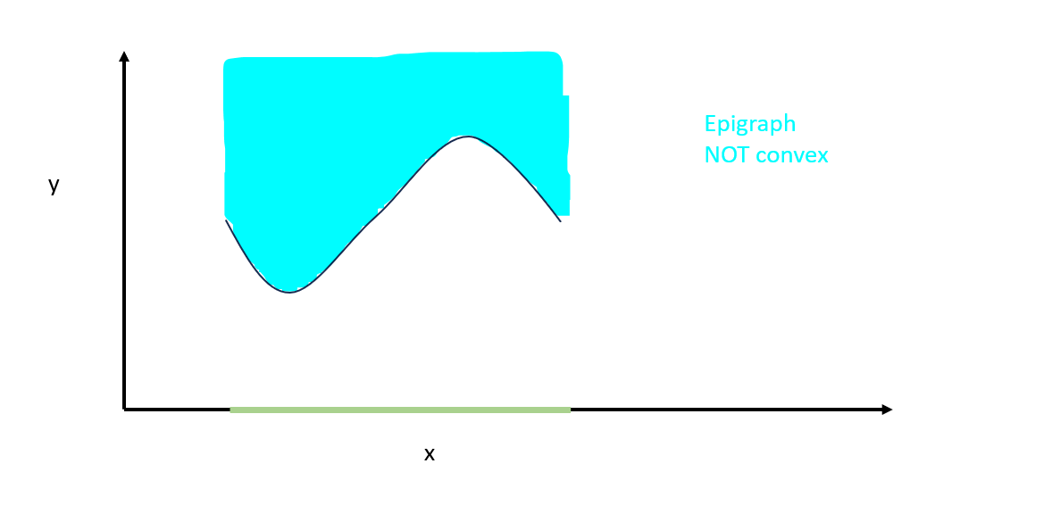
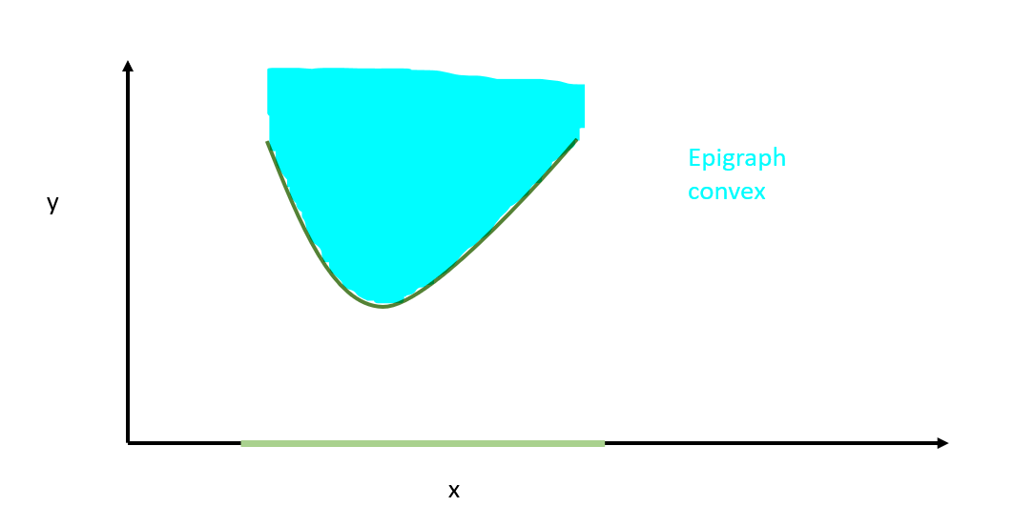
3. Linear programming
A. Optimization: brief introduction
ii. Convex optimization
October 24, 2023
What does it mean that a function is convex?
A function is convex if its epigraph is convex, namely if the set above the graph of the function is convex, graphically:
Gridworld: value iteration VS linear programming
S. Lippolis, G. Marsich
26/40

Slide 28
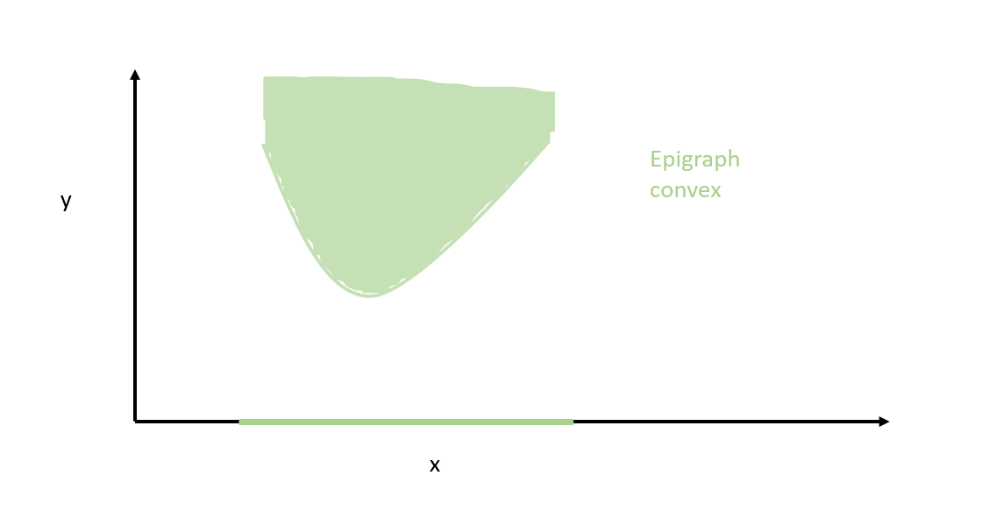
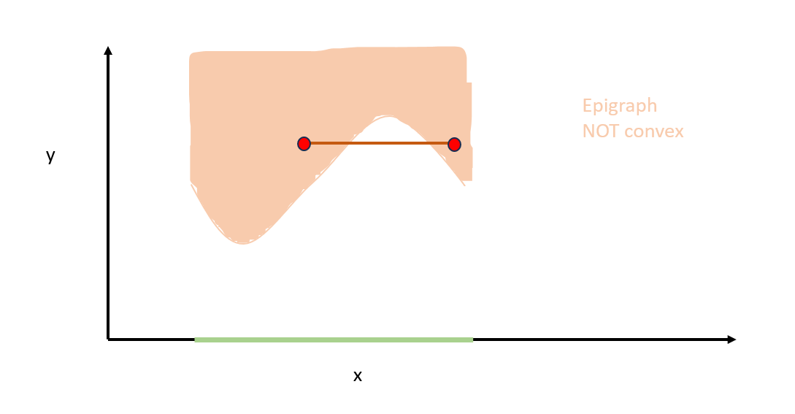
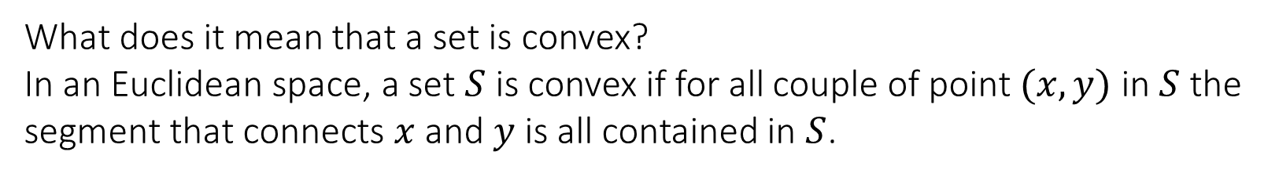
3. Linear programming
A. Optimization: brief introduction
ii. Convex optimization
October 24, 2023
What does it mean that a set is convex?
In an Euclidean space, a set $S$ is convex if for all couple of point $(x,y)$ in $S$ the segment that connects $x$ and $y$ is all contained in $S$.
Gridworld: value iteration VS linear programming
S. Lippolis, G. Marsich
27/40

Slide 29
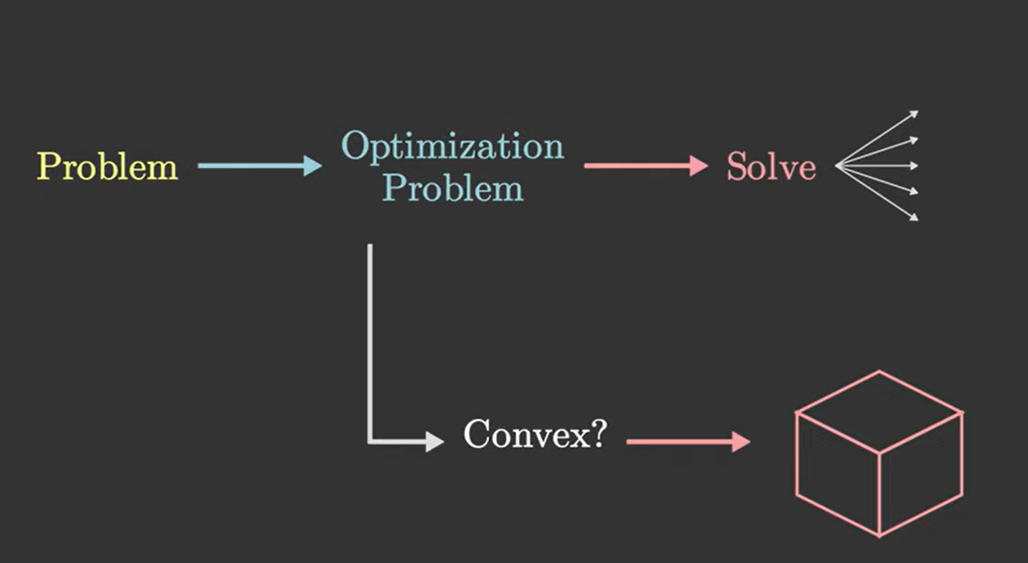
3. Linear programming
A. Optimization: brief introduction
ii. Convex optimization
October 24, 2023
Convexity utility:
If a problem is convex, you can solve it “easily”
Gridworld: value iteration VS linear programming
S. Lippolis, G. Marsich
28/40

Slide 30
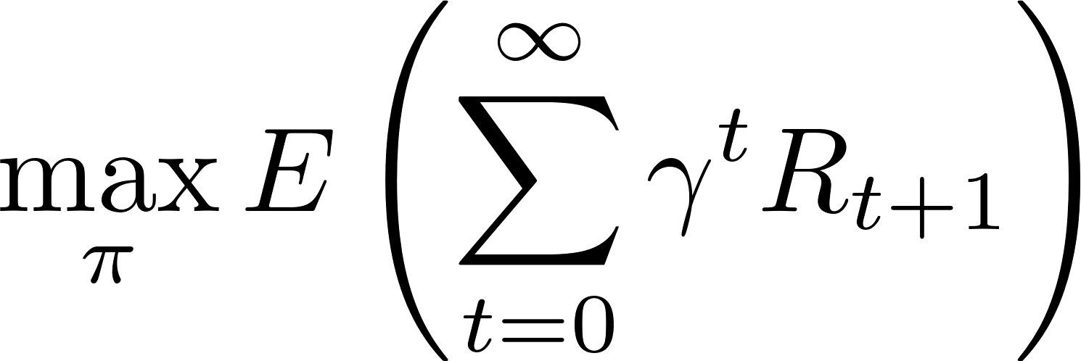
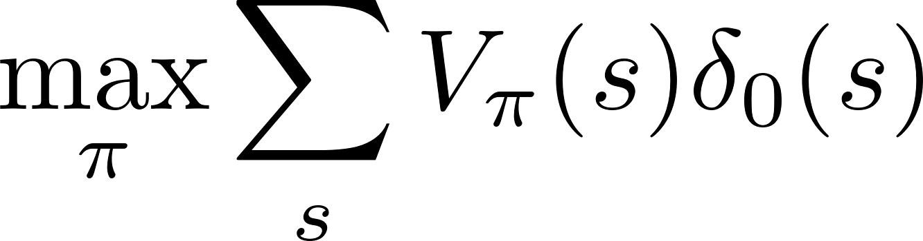
3. Linear programming
B. Linear programming for Gridworld
i. Formalisation
October 24, 2023
Gridworld: value iteration VS linear programming
S. Lippolis, G. Marsich
29/40

Slide 31
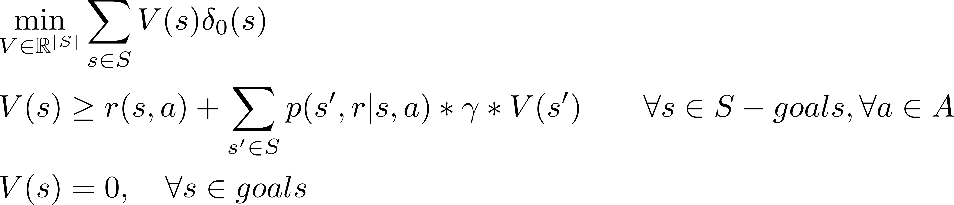
3. Linear programming
B. Linear programming for Gridworld
i. Formalisation
October 24, 2023
Gridworld: value iteration VS linear programming
S. Lippolis, G. Marsich
30/40

Slide 32
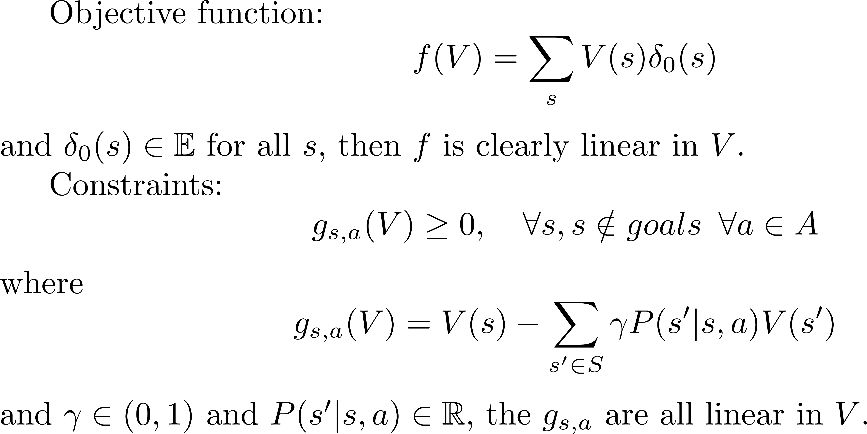
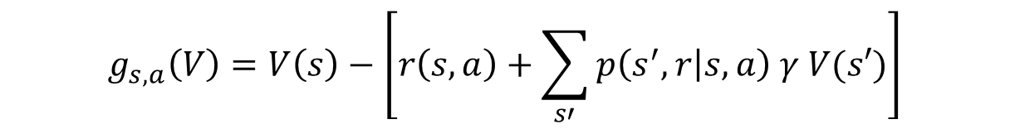

3. Linear programming
B. Linear programming for Gridworld
ii. Linearity
October 24, 2023
We can use fast methods as the simplex method and interior-point
$$g_{s,a}\left(V\right)=V\left(s\right)−\left[r\left(s, a\right)+\sum_{s′}{p\left(s^{′},r | s, a\right) γ V(s′)}\right]$$
Geometrical view of linearity
Gridworld: value iteration VS linear programming
S. Lippolis, G. Marsich
31/40

Slide 33
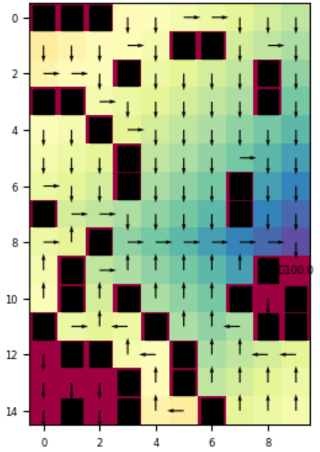
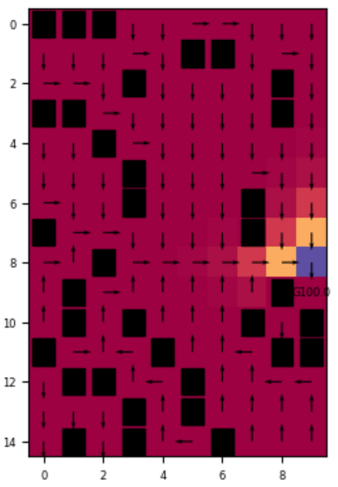
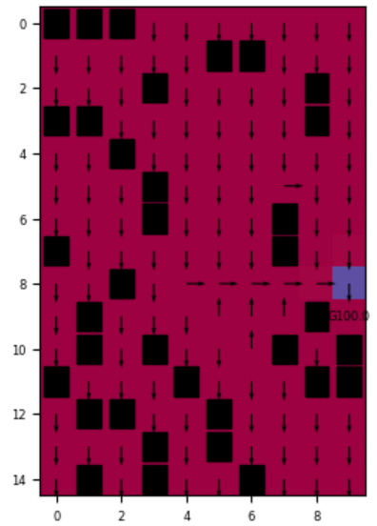
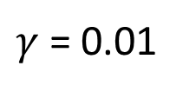
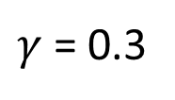
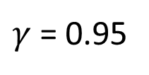
3. Linear programming
C. Solution discussion
i. One goal
October 24, 2023
$$γ=effective time="how far can we see in the future"$$
$γ$ = 0.95
$γ$ = 0.3
$γ$ = 0.01
Gridworld: value iteration VS linear programming
S. Lippolis, G. Marsich
32/40

Slide 34
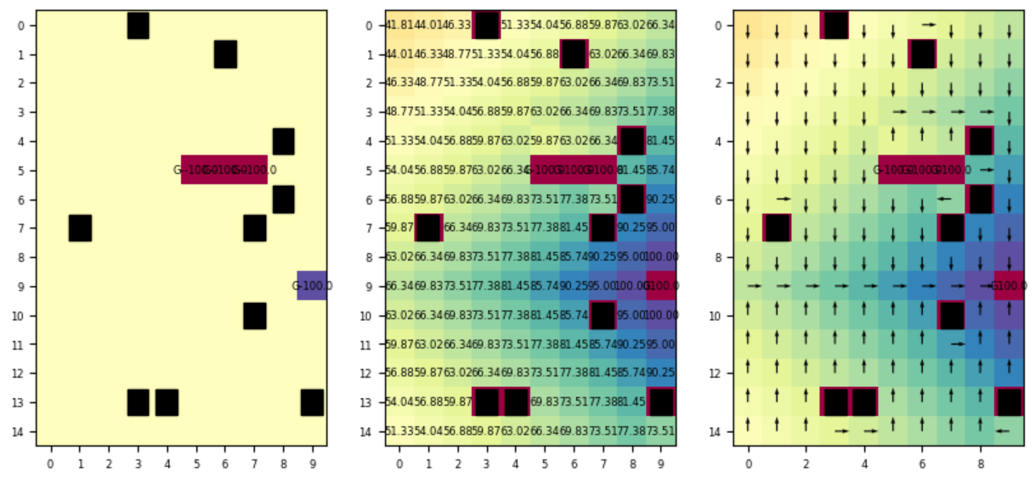
3. Linear programming
C. Solution discussion
ii. Ravine
October 24, 2023
$$Ravine=consecutive states with really negative rewards$$
With LP, it
does not have
fear of the ravine
Gridworld: value iteration VS linear programming
S. Lippolis, G. Marsich
33/40

Slide 35




3. Linear programming
C. Solution discussion
iii. Multigoals
October 24, 2023
Behaviour with multiple goals
$γ$ = 0.95
$γ$ = 0.3
Forward-looking
More greedy
Gridworld: value iteration VS linear programming
S. Lippolis, G. Marsich
34/40

Slide 36
4. Comparison
October 24, 2023
4. Comparison
Gridworld: value iteration VS linear programming
S. Lippolis, G. Marsich
35/40

Slide 37


4. Comparison
A. Conceptual comparison
October 24, 2023
Value iteration:
The value is a concrete vector that is updated many times.
Linear programming:
The value is a variable.
It moves around the feasible set in $ℝ^{|S|}$
trying to minimize $\sum_{s∈S}{V(s)δ(s)}$
Gridworld: value iteration VS linear programming
S. Lippolis, G. Marsich
36/40

Slide 38

4. Comparison
B. Performance comparison
October 24, 2023
Gridworld: value iteration VS linear programming
S. Lippolis, G. Marsich
37/40

Slide 39
References
October 24, 2023
Notes of the Reinforcement learning 2022/2023 course, prof. Celani, Università degli Studi di Trieste
Notes of the Mathematical optimisation 2022/2023 course, prof. Castelli, Università degli Studi di Trieste
What is mathematical optimization video, Visually explained channel, Youtube
Convexity and The Principle of Duality video, Visually explained channel, Youtube
ChatGPT OpenAI, Introducing ChatGPT (openai.com)
Wikipedia, Wikipedia, l'enciclopedia libera
Gurobi optimizer commercial optimization software, The Leader in Decision Intelligence Technology - Gurobi Optimization
PuLP LP modeler, PuLP · PyPI
Gridworld: value iteration VS linear programming
S. Lippolis, G. Marsich
38/40
15/15

Slide 40
Report of the work done
October 24, 2023
SL: Samuele Lippolis
GM: Gaia Marsich
MDP: Markov decision process
LP: linear programming
IMPORTANT: names in surname alphabetical order, not contribution importance
Start
* Organization: Topic choice - SL and GM
* Organization: Work parallelization plan – SL
Value iteration
* Practical: MDP with VI: notebook and py libraries - SL
* Theoretical: MDP with VI theoretical analysis - GM
* Practical: MDP with VI notebook results analysis - GM
* Organization: MDP with VI result discussion: SL and GM
* Practical: evolutionary gif production - GM
* Practical: time analysis – GM
Optimisation and linear programming
* Theoretical: LP: basic concepts - SL
* Theoretical: LP: solving MDP with LP - SL
* Practical: MDP with LP: notebook and py libraries - SL
* Organization: MDP with LP result discussion: SL and GM
Comparison
* Theoretical: theoretical comparison between the 2 methods - SL
* Practical: result comparison between the 2 methods - SL
End
* Practical: slides - SL and GM
* Practical: check slides and notebook: GM
Gridworld: value iteration VS linear programming
S. Lippolis, G. Marsich
39/40
15/15

Slide 41
October 24, 2023
Gridworld: value iteration
VS linear programming
Thank you for the attention!
Samuele Lippolis | Gaia Marsich
Gridworld: value iteration VS linear programming
S. Lippolis, G. Marsich
40/40
15/15

Slide 42

3. Linear programming
A. Optimization: brief introduction
ii. Convex optimization
October 24, 2023
Get back to the presentation
Gridworld: value iteration VS linear programming
S. Lippolis, G. Marsich

Slide 43


3. Linear programming
B. Linear programming for Gridworld
ii. Linearity
October 24, 2023
Get back to the presentation
Gridworld: value iteration VS linear programming
S. Lippolis, G. Marsich

